Slide 1
The Costal Plain
By: Jacob warren

Slide 2
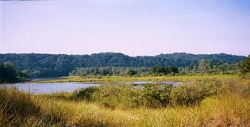
Where is it at?
The Costal Plane is in southern most Georgia and goes from the fall line to the barrier islands.

Slide 3
How many people live there?
Somewhere within 50% of Georgia's Population lives their.

Slide 4
Info
This was the first region to be found in Georgia.
It contains the Okefenokee Swamp.
It is the largest region in Georgia.
It has many forest.
We do not live in it.

Slide 5
Funny Time

Slide 6
More info
This is where most of Georgia's onions and peanuts are grown.
Some soil in this region is poor and some is great for farming.
It also contains Radium Springs, Providence Canyon, and Warm Springs.

Slide 7
For Mrs.Morris
Just Kidding!

Slide 8
For mrs.west
Now this is true.

Slide 9
Thank You
If you are reading this right now you have made it to the end I hope you learned something and laughed a little!

